Slide 1







Building Web Apps Using your GeoJSON, CSV, and OGC data
Anne Fitz and Jose Banuelos
2021 ESRI DEVELOPER SUMMIT
Notes:
Introduce the session and ourselves

Slide 2


Agenda
Using external data
with the ArcGIS API
for JavaScript
GeoJSON
CSV
OGC
Notes:
I just wanted to briefly go over what we will cover today before we dive in. First we’ll talk about using external data with the ArcGIS API for JavaScript, and then we will move into some specific data types and create some awesome web apps using this data! In this session, we will talk about GeoJSON, OGC, and CSV data.

Slide 3
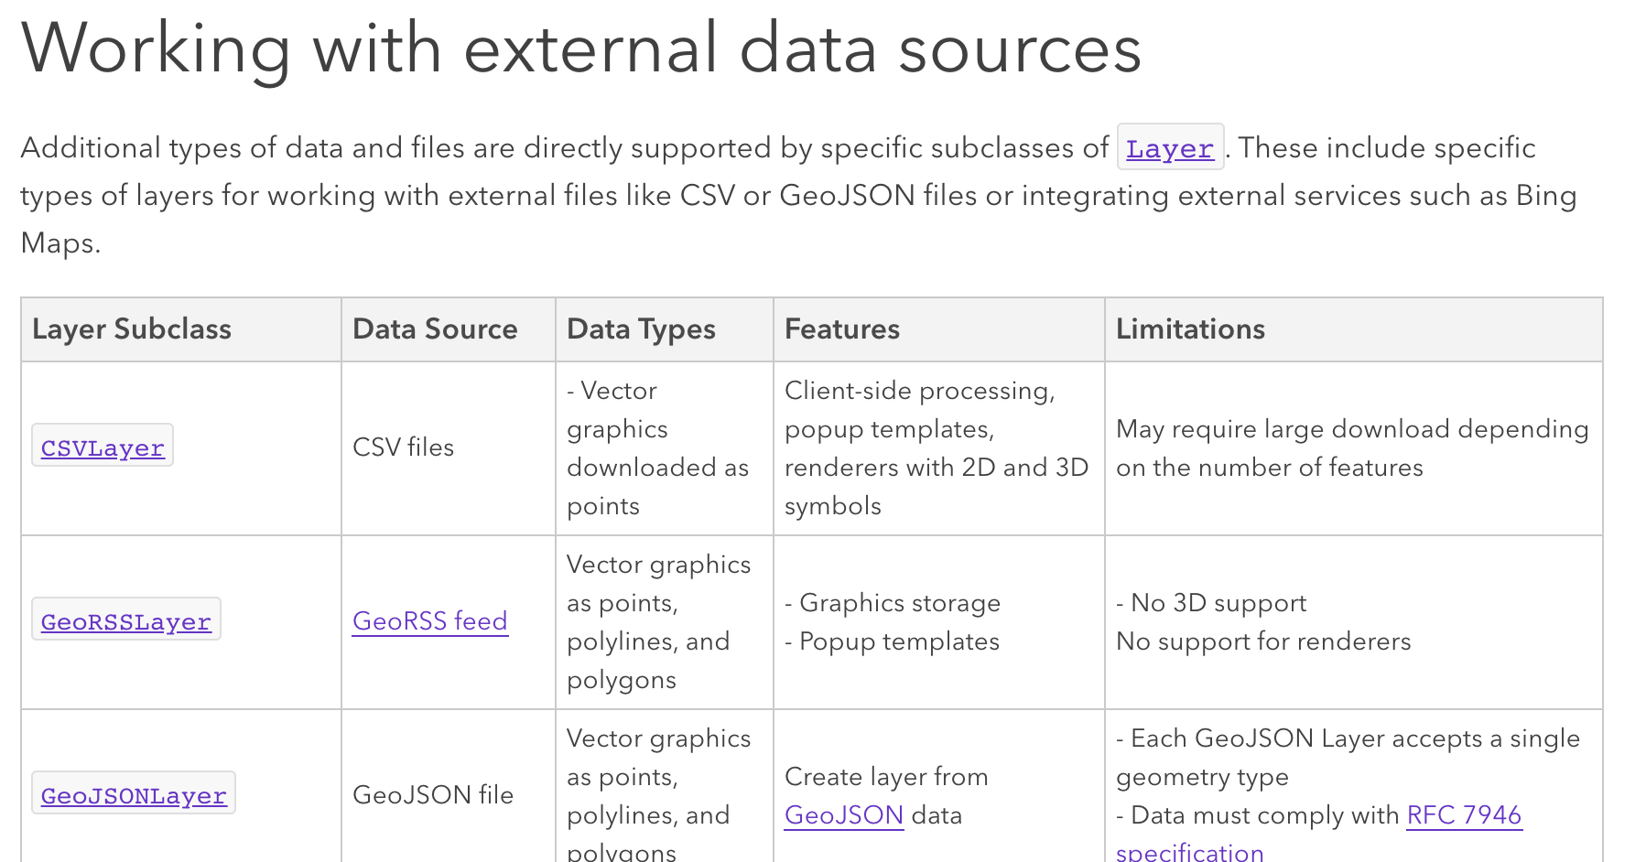
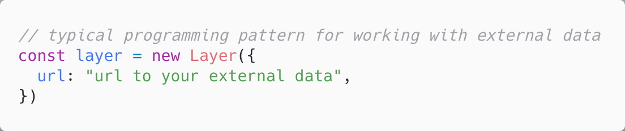
Using external data with the ArcGIS API for JavaScript
Different subclasses of Layer based on the data type
Notes:
So first we’re gonna talk about using external data with the ArcGIS API for JavaScript. I wanted to show you all this guide page that talks about basic programming patterns for layers and data in our API. On this page, there’s a section called ”Working with external data sources” and it contains all of the different layer types that we offer that use external data with more information (like features and limitations) and links to the layer’s documentation. All of these layers mentioned here are just different subclasses of the layerbase class, based on the data type.
Bringing data into your app as a layer with the javascript api could not be easier. The typical programming pattern for creating a layer would be to add that layer type in the require statement, and then use a code snippet similar to this one, where you would replace “Layer” with the appropriate layer type based on your data, set the URL property and any additional properties that your layer requires.
Now, I’m going to pass it off to Jose who will talk to us about the GeoJSON layer type.

Slide 4







GeoJSON
Jose Banuelos
Notes:
In this section, we will discuss what GeoJSON is, a little history, and its features. We will then dive into how we can use this data format with the ArcGIS API for JavaScript, to take advantage of its features.

Slide 5
History
Published in 2008
Replaced in 2016 (RFC 7946)
Notes:
GeoJSON is a geospatial data interchange format based on the JavaScript Object Notation (JSON).
The GeoJSON specification was published in 2008 (GeoJSON Version 1.0), and later replaced in 2016 by a new specification. The new specification is RFC 7946. These specifications illustrate the features and the standards for this data format.

Slide 6
Features
Geometry, a feature, or a collection of features.
World Geodetic System 1984 (WGS84) datum
GeoJSON fixed types
GeoJSON Geometry Object | API Geometry Type
Point | Point
MultiPoint | Multipoint
LineString/MultiLineString | Polyline
Polygon/MultiPolygon | Polygon
Notes:
The RFC7946 standards state that a GeoJSON object may represent a geometry, a feature, or a collection of features.
All GeoJSON coordinates must use the World Geodetic System 1984 (WGS84) datum, with longitude and latitude decimal degrees units.
GeoJSON supports the following geometry types and geometric objects: FeatureCollection, Feature, Point, LineString, MultiPoint, Polygon, MultiLineString, MultiPolygon, and GeometryCollection.
The table shows the supported geometry objects from GeoJSON and their corresponding geometry types in our API.

Slide 7
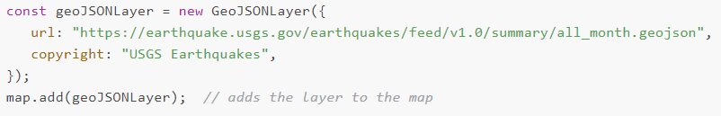
The ArcGIS API for JavaScript GeoJSONLayer
Features
Clustering
Client-side querying
Widgets
Projection
Notes:
The ArcGIS API for JavaScript provides a GeoJSONLayer to fully support GeoJSON data sources. The layer allows you to load the data by referencing a url, as you can see here.
If you’d rather load a GeoJSON object into the layer, you can do that by creating a blob. We won't get into much detail with this alternative workflow, but if you are curious as to how you can use a blob to load GeoJSON objects, you can take a look at our blob sample demo that will be provided with the rest of the demos for this presentation.
The API allows users to take GeoJSON data, and visualize the data with features that are available with the FeatureLayer.
For instance, the featureReduction property of the GeoJSONLayer allows us to cluster points!
Since the GeoJSONLayer is a client-side layer, it will store all of its features on the client-side when they load. Therefore, all subsequent queries will not require server requests.
The API also allows users with GeoJSON data to access their data in its many widgets.
We have a demo where we will utilize the TimeSlider widget with our GeoJSONLayer coming up soon to demonstrate this.
As mentioned earlier, GeoJSON coordinates must use the WGS84 geographic coordinate reference system. Because of this, the maps were limited to using WGS84 or Web Mercator spatial references in earlier versions of the API.
Now, the GeoJSONLayer can be projected to a map's coordinate system. While the GeoJSON data will still be limited to WGS84, the map or basemap can be in any projection.

Slide 8

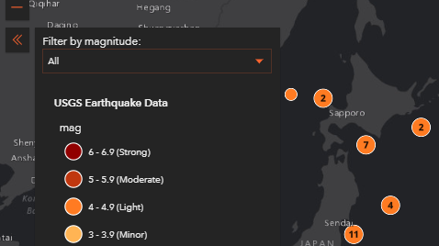


GeoJSONLayer
Jose Banuelos

Slide 9
OGC data
WMS
WMTS
WCS
OGC API Features
Notes:
Next we’re going to talk about OGC data. OGC stands for the Open Geospatial Consortium, which is a global community that creates geospatial standards for the web. We support 4 different OGC data types and have a layer for each one – WMS (web map service), WMTS (web map tile service), WCS (web coverage service), and OGC API – Features (feature service)

Slide 10
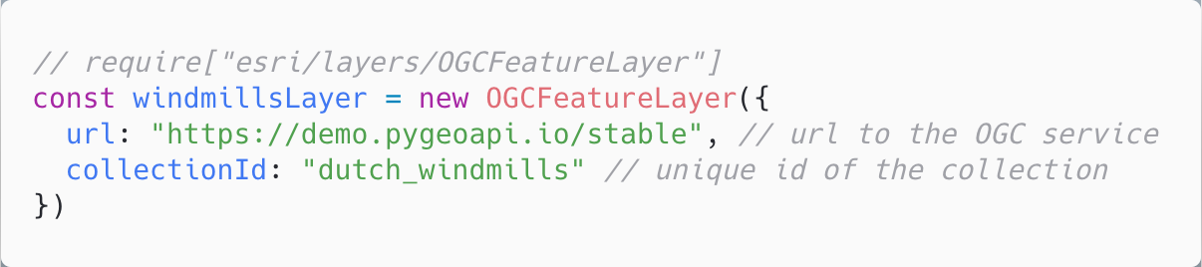
OGCFeatureLayer
Based on an OGC API – Features service
Geospatial data is stored in “collections”
Part 1 published October 2019
Previously referred to as WFS3
Support added in our API at version 4.16 (Summer 2020)
Layer capabilities
Rendering (visual variables)
Labeling
Popups
Querying
Clustering
Layer blending
Notes:
So today we’re going to focus on the OGCFeatureLayer, which gets its data from an OGC API – Features service. This is one of the newer OGC data services (part 1 of the specification was published in October 2019) and we added support for this in our API this past summer. The service is comprised of geospatial data stored in collections, and it was previously referred to as WFS3 before it was published, so if you’re familiar with WFS then this is similar. This is a features service, so by using this layer type you are bringing features into to your map and can interact with them in a similar way as features from a FeatureLayer. This layer supports rendering, labeling, popups, querying, etc
To create the layer, you just have to specify the url and collectionId and then you are ready to go.
Before we get into the demo, I wanted to show you all what it looks like when viewing an OGC API features service on the web. So this is the service I will be using for my demo today - I can click to view the collections in this service and it lists the different collections of features that are available. Today, we're going to look at Windmills in the Netherlands, so I can click on that service to learn more. From here, you can browse the data and view additional information. But the main thing we're looking for on this page is the collectionId which we can find in the URL. in this case it's dutch_windmills. Now that we have the url to our service and the collectionId for the features we want to show, lets see how we can create the OGCFeatureLayer and add it to a map.
**Transition to demo**

Slide 11
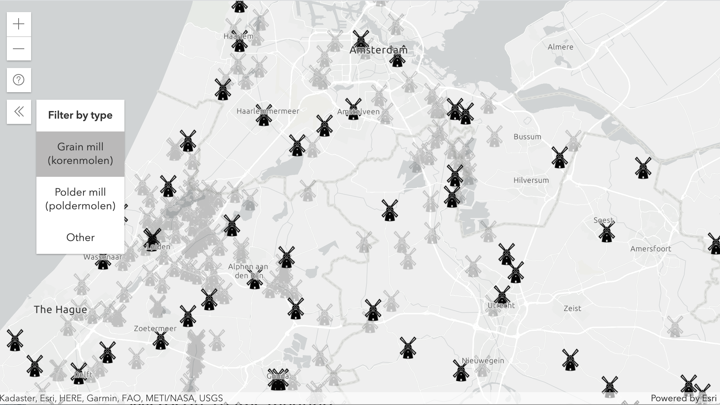
OGCFeatureLayer
Anne Fitz

Slide 12
CSV
Jose Banuelos
Notes:
Thank you. So, I bet more of you are more familiar with csv data, whether you have used it in your web applications, or even just reading an excel spreadsheet. CSV is a plain-text file format used to represent tabular data, and can include geographic point features (latitude, longitude).
This tabular data is very simple and easy to generate, import, and export from applications or programs.

Slide 13
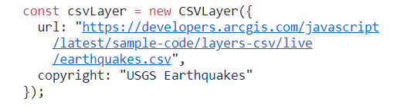
CSVLayer
Lat / Long automatic detection
CSVLayer.latitudeField
CSVLayer.longitudeField
Notes:
The ArcGIS API for JavaScript's CSVLayer allows us to utilize the location or geographical data in a csv file, and visualize it on a Map. The CSVLayer expects latitude and longitude coordinates, so it will automatically detect these fields.
For the latitude field (if not specified), the API will automatically look for field names in the file such as "lat", "latitude", "y", and a few others...
For the longitude field (if not specified), the API will look for field names such as "lon", "lng", "longitude", "x", and a few others.
The common approach to load a CSVLayer is via a url pointing to the csv file as you can see in the code on the slide.

Slide 14
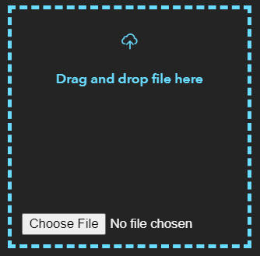
CSVLayer Features
Same as a GeoJSONLayer
Upload a .csv file and display the data immediately
Notes:
The CSVLayer takes advantage of the same capabilities as the GeoJSONLayer. This layer is also a client-side layer like the GeoJSONLayer, so itt loads all of its features on the client-side on initial load. The rest of the queries operate on the client-side. In the demo coming up, we will take advantage of one of the client-side layer features, and that is the ability to upload the csv file directly from your computer, and visualize the data immediately on a Map. This will save some valuable time for us all.

Slide 15
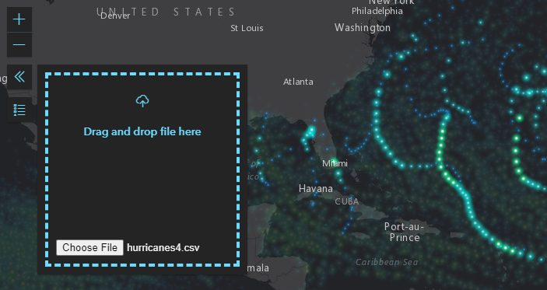
Demo Title
Presenter(s)

Slide 16
Demos and slides available at https://arcg.is/0qne0G

Slide 17








Please provide your feedback for this session by clicking on the session survey link directly below the video.

Slide 18

Copyright © 2021 Esri. All rights reserved.

